Slide 1
Digital System Design CE 325 L1 SPRING 2024
Instructor : Dr. Syed Arsalan Jawed
Associate Professor of Practice
arsalan.jawed@sse.habib.edu.pk
Room : W-301
Office Hours : Monday 0930-1030, Wednesday 1430-1530, Friday 0930-1030

Slide 2
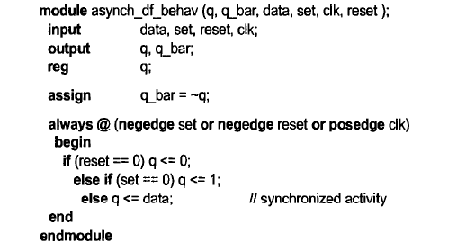
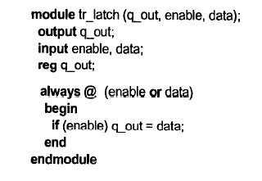
Cyclic Behavioral Models
Continuous assignment cannot model edge-sensitive behavior
Unless we ourselves combine two latches
CBM → do not end with their last procedural statement
They re-execute

Slide 3
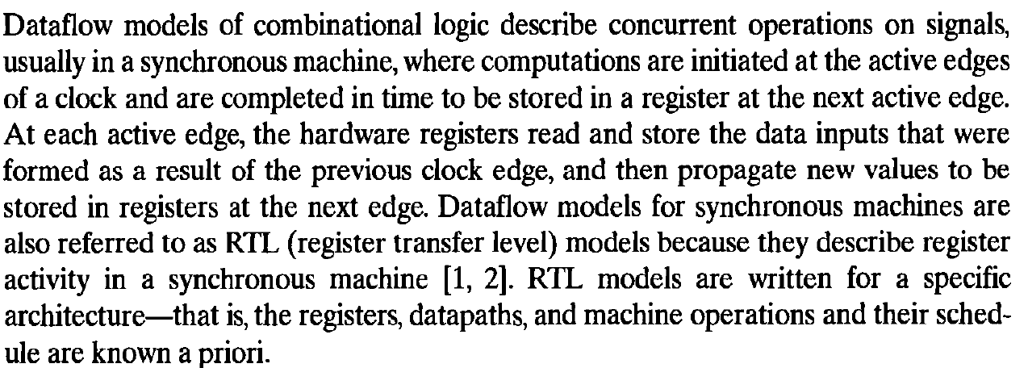
RTL Models / Dataflow / Edge Detection

Slide 4
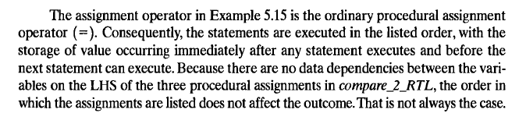
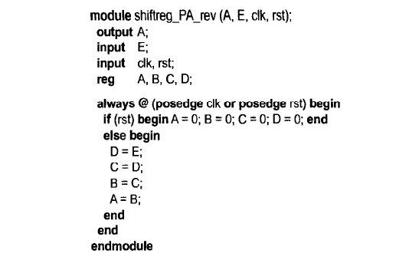
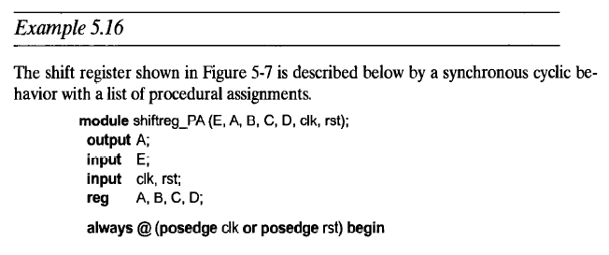
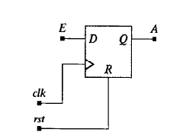
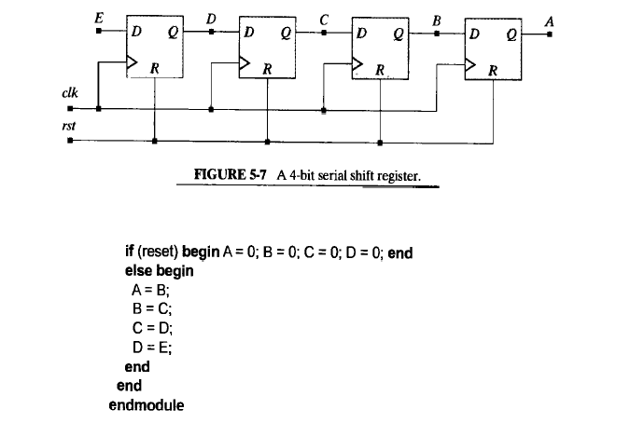
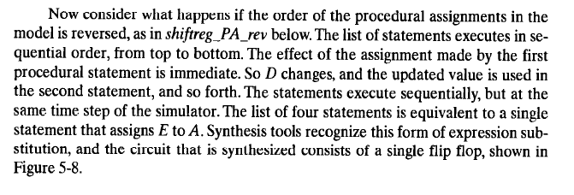
RTL Models / Problem with Blocking Assignment

Slide 5
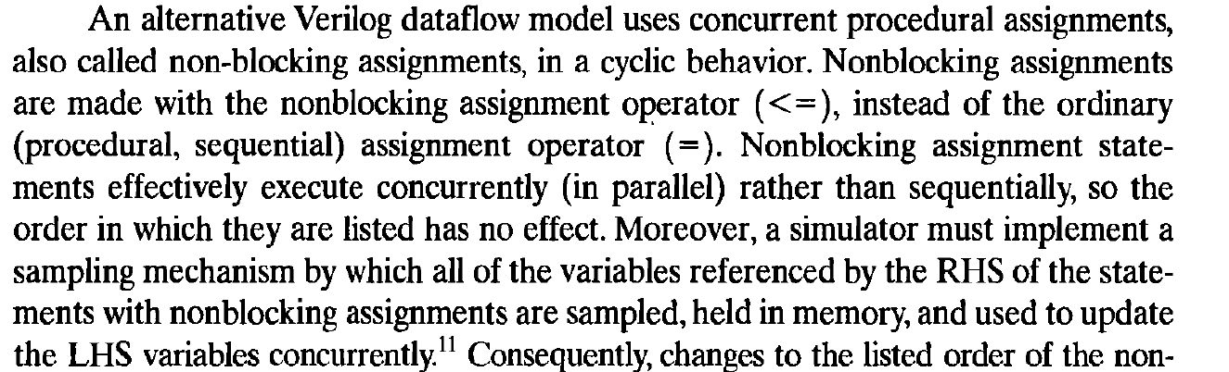
The Non Blocking Assignment - Concurrent

Slide 6
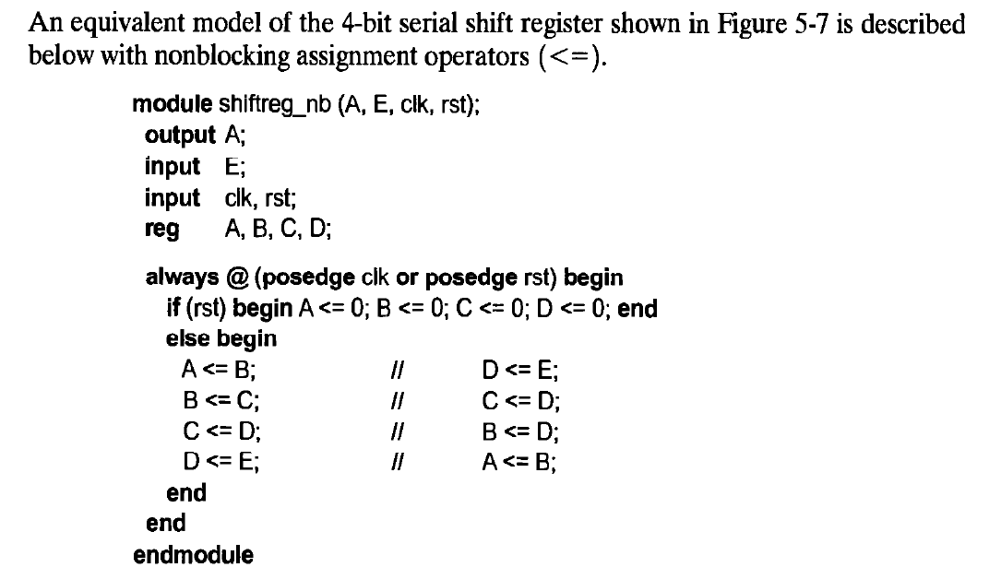
No Change due to sequence as above with blocking assignment

Slide 7
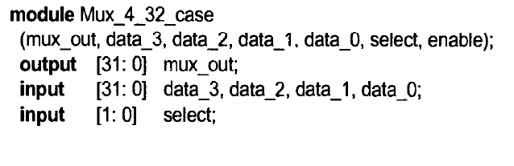
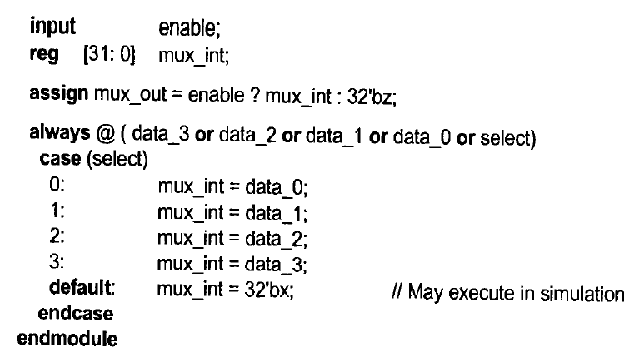
Behavioral Models of Muxes, Encoders, Decoder
Before, we observed gate-level implementation of these blocks.
Here, we see alternate level sensitive behavioral descriptions

Slide 8
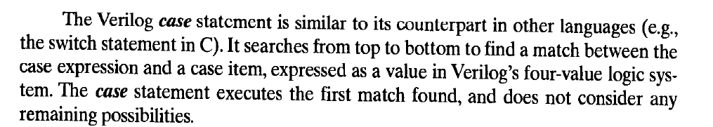
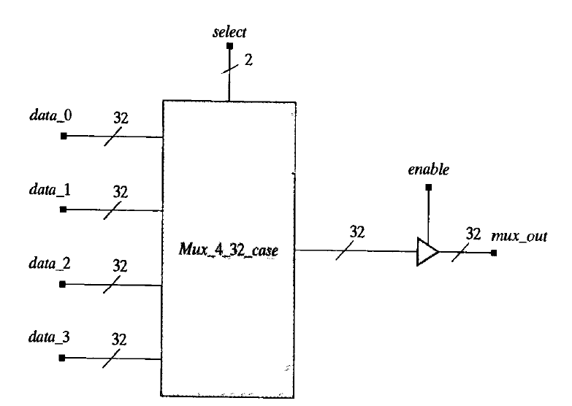
Behavioral Models of Muxes, Encoders, Decoder
We will study full_case and parallel_case attributes for synthesizers

Slide 9
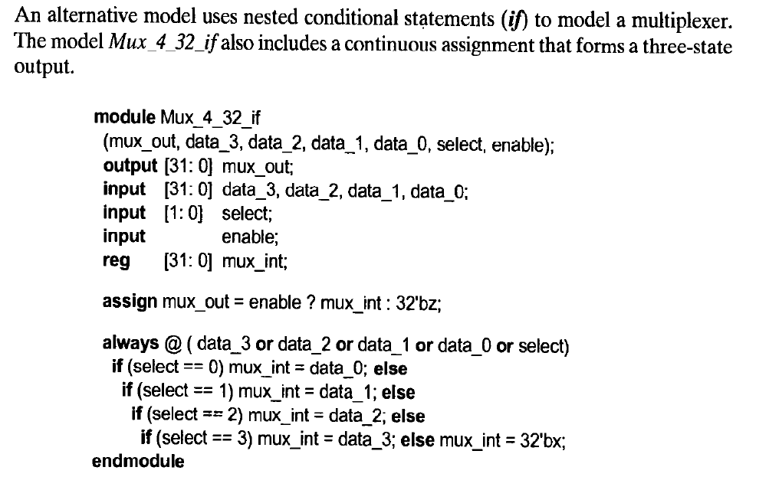
Encoder

Slide 10
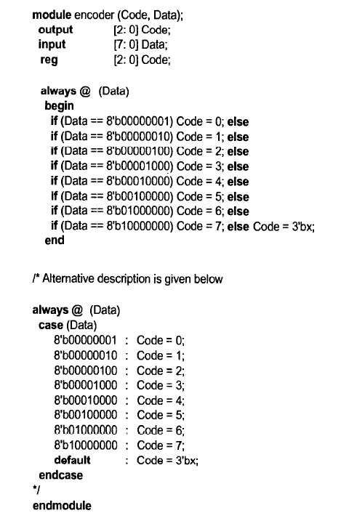
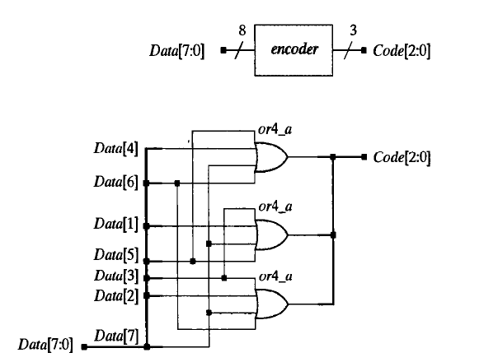

Slide 11
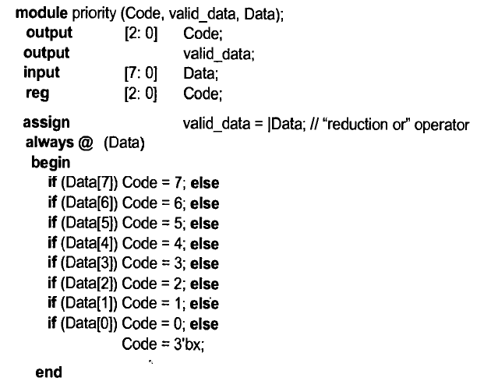
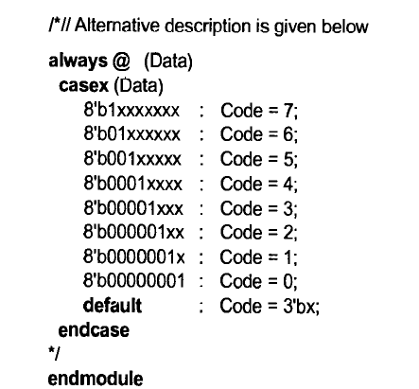
Priority Encoder

Slide 12
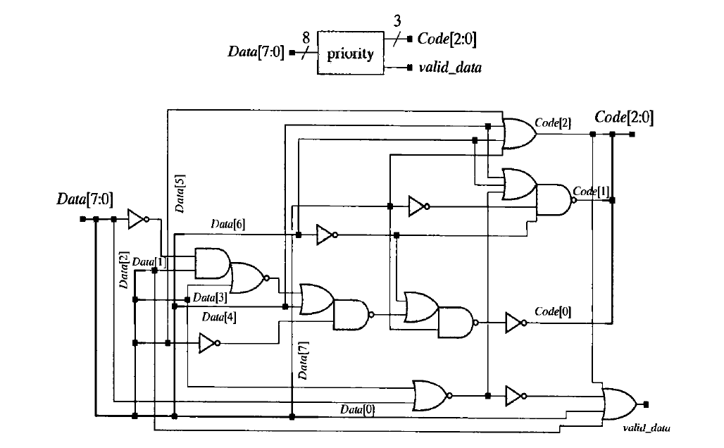
Priority Encoder

Slide 13
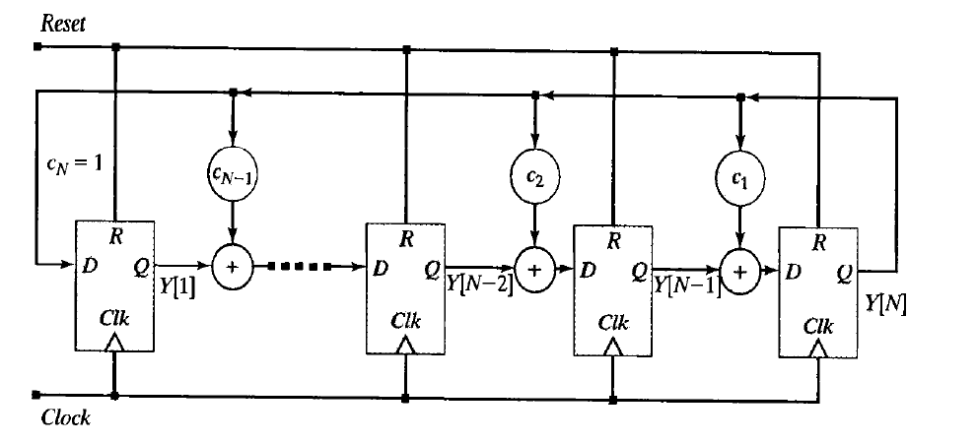
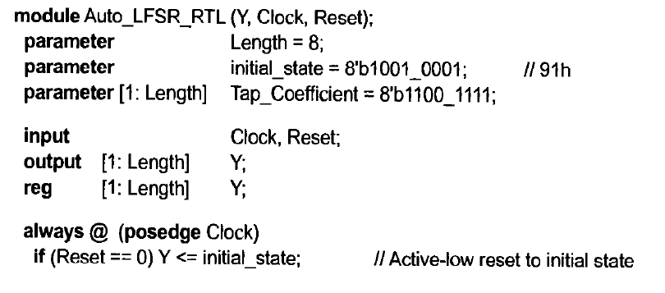
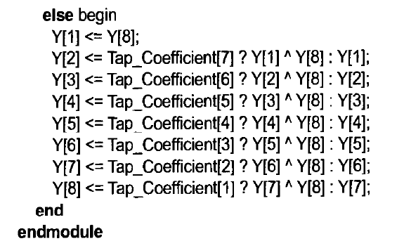
Linear Feedback Shift Registers

Slide 14
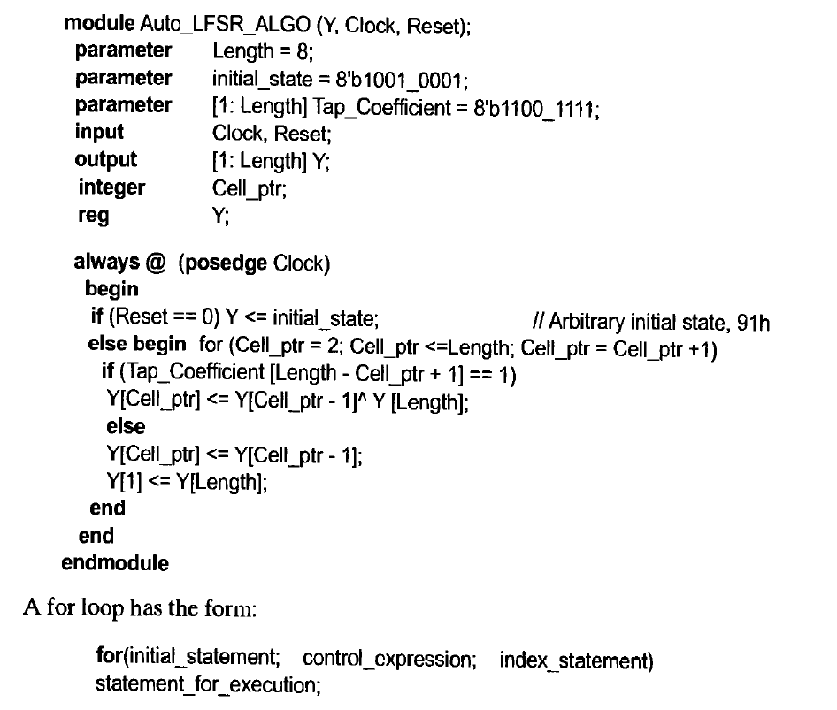
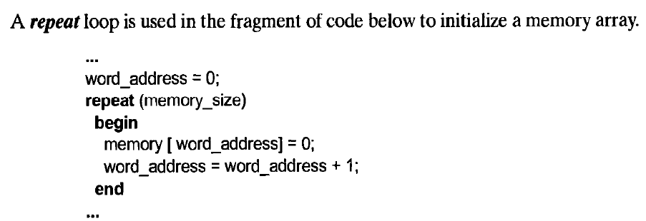
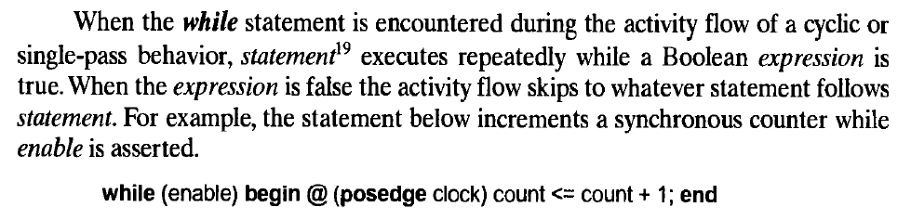
Loops

Slide 15
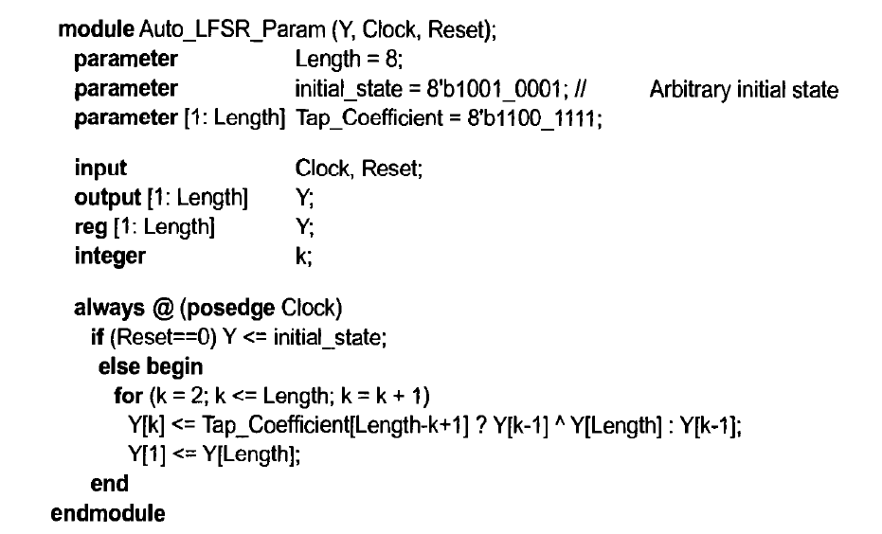
Intellectual Property Reuse and Parameterized Models

Slide 16
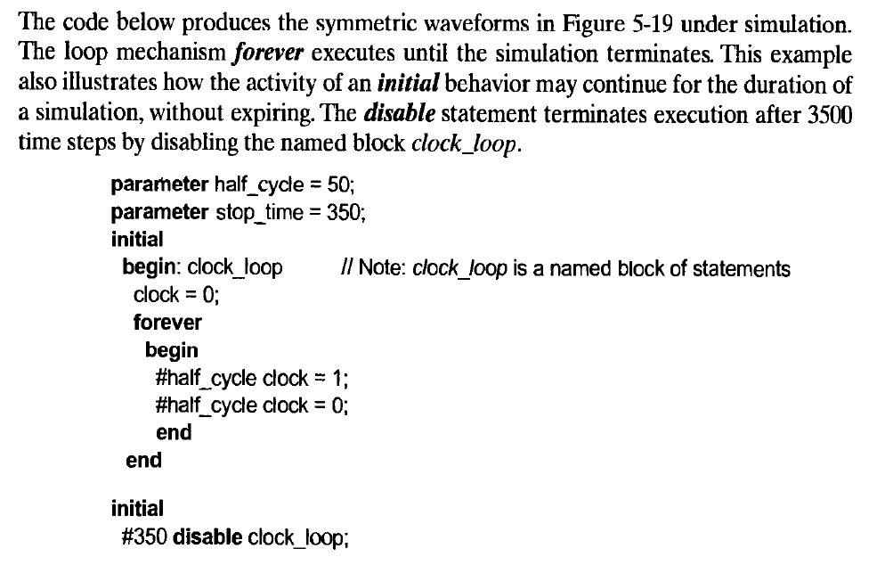
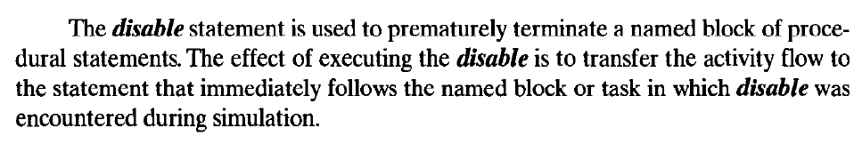
Clock Generation for Simulation

Slide 17
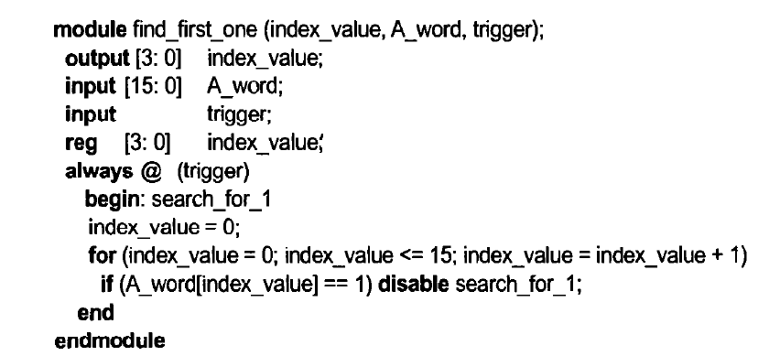
Use of for loop and disable statement combined

Slide 18
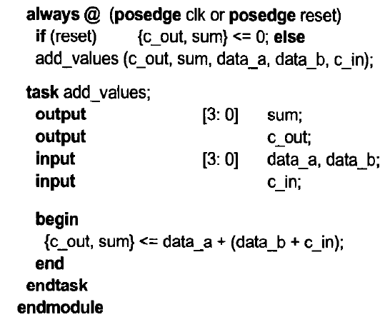
Tasks

Slide 19
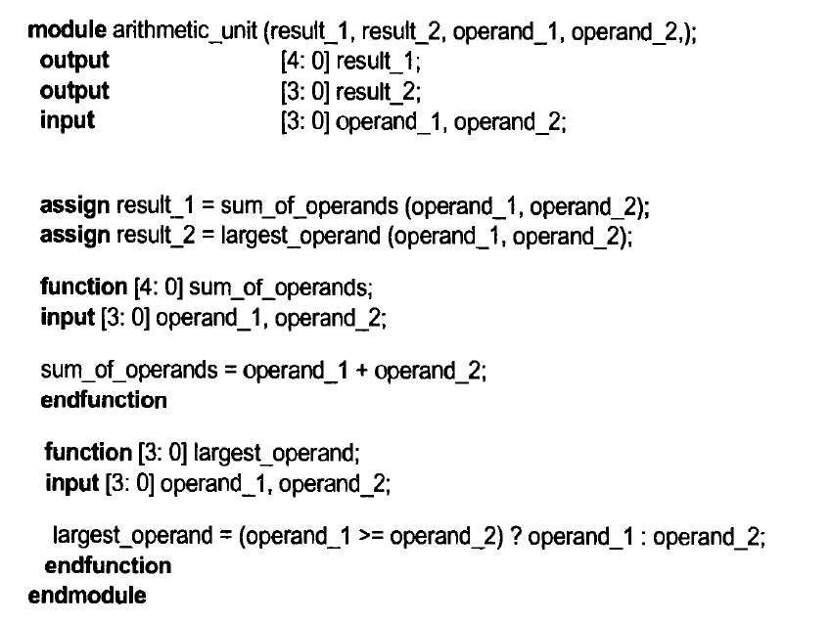
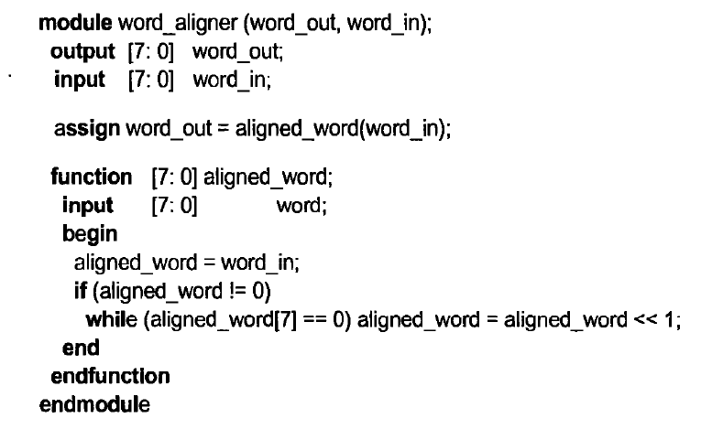
Functions

Slide 20
Self-Study
Counters
Shift Registers
ASM Charts

Slide 21
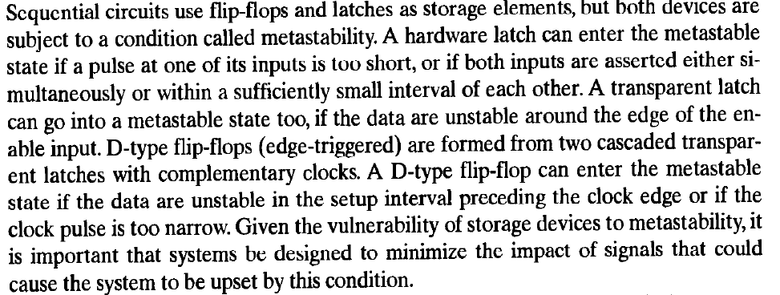
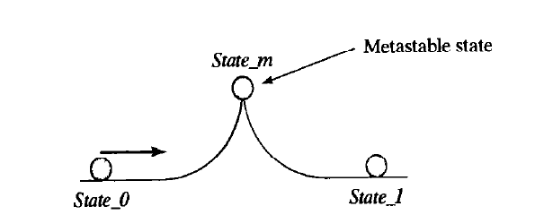
Switch Debounce, Metastability and Synchronizers for Asynchronous Signals

Slide 22
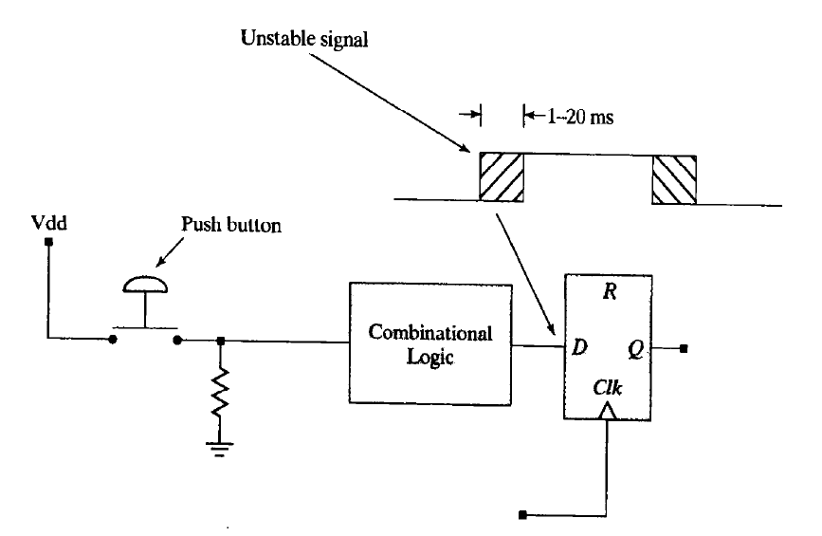
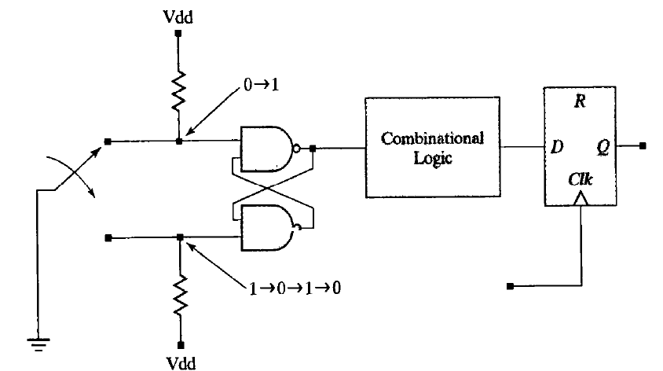

Slide 23
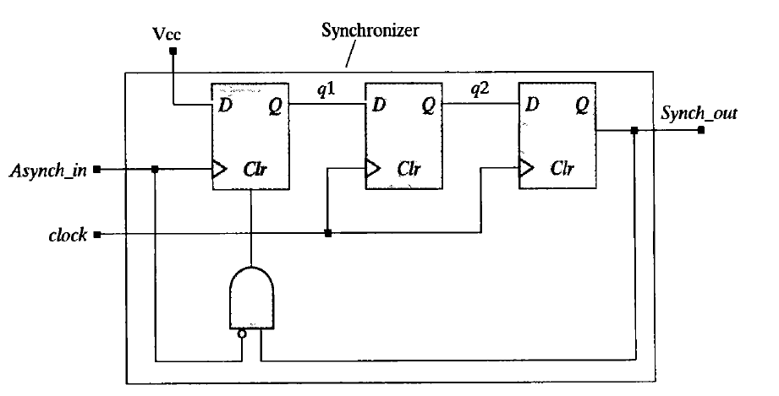
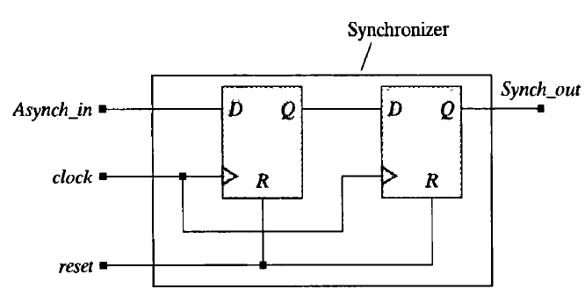
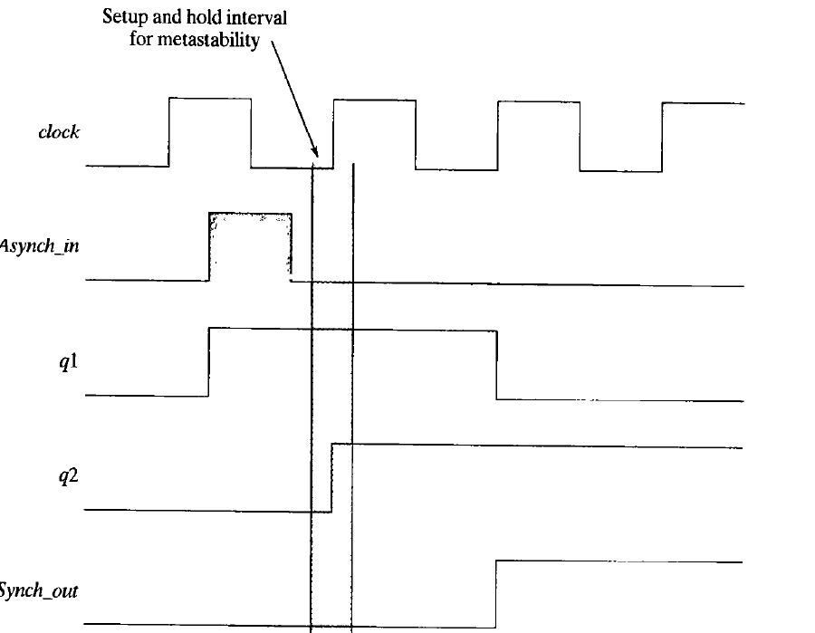

Slide 24
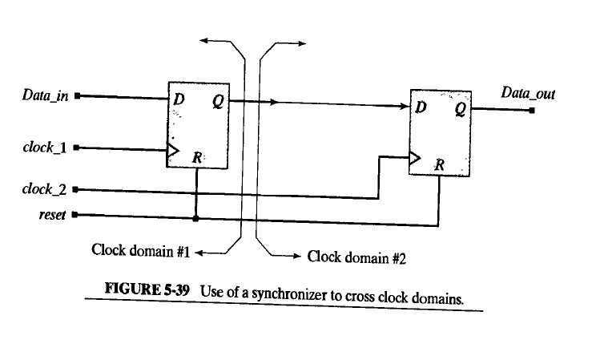
Multiple Clock Domains
End of Chapter 5 : Text Book Ciletti

